Slide 1
Fundamental Analysis 101 (Equities)

Slide 2
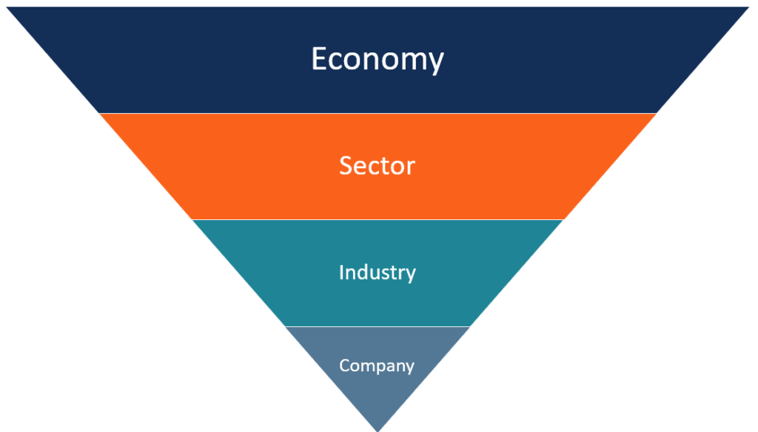
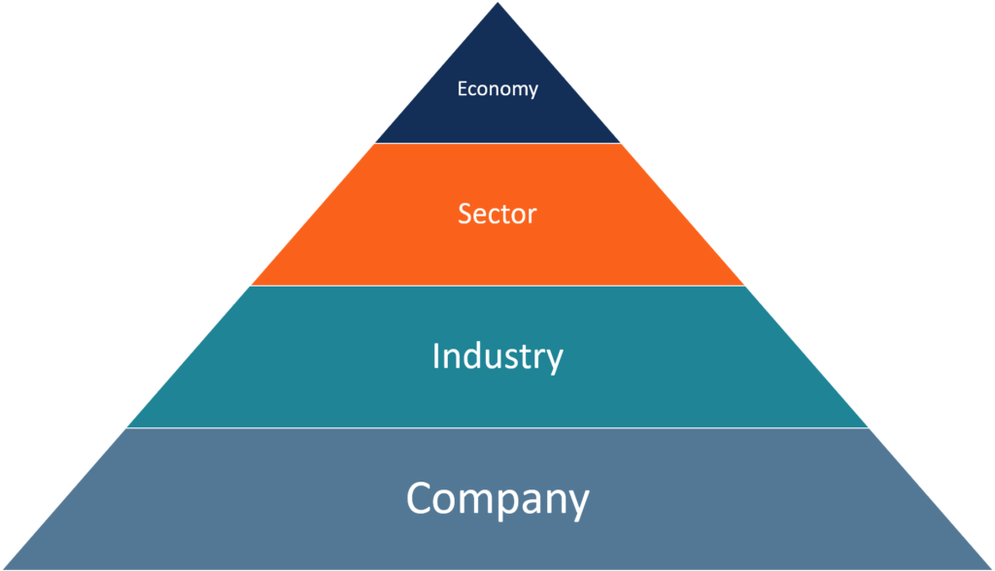
2 Approaches To Source For Investment Ideas
Top Down Approach
Bottom Up Approach

Slide 3
Top Down Approach Example
Look at general market conditions: E.g. Trade war tensions, No deal Brexit looming, Hong Kong prolonged protests
Investors all seeking safe heaven assets in the midst of growing uncertainties: E.g Gold
Gold Mining, Gold Explorers, Gold Processing, Gold Royalties
Look out for the market leaders in the respective industry

Slide 4
Bottom Up Approach Example
How is the trade war affecting the sector and industry? Will Snap be involved in the trade war?
What is the outlook of the information technology sector, trends in the sector etc.
Social Media industry market share, trends in the industry etc.
“Snap shares plunge after Facebook’s latest clone attempt”

Slide 5
Platforms To Source For Investment Ideas
Industry Primers: https://drive.google.com/drive/folders/1svU7FplngovrmlpZUlTiLfVqNqe-NqkX
Trade Magazines/Journal e.g. Economist, Forbes
News articles e.g. CNBC, MarketWatch, Bloomberg, Finimize
Terminals e.g. Bloomberg, Reuters Eikon, S&P Capital IQ

Slide 6
Building A Stock Pitch Deck

Slide 7
Outline
Executive Summary
Business Overview
Industry Overview
Investment Thesis
Valuation
Investment Risk

Slide 8
Executive Summary
Overview of your findings
What do you recommend?
Why do you recommend?
At what target price & potential gains (normally 1-2 years horizon)

Slide 9

Executive Summary
Investment Proposal
BUY recommendation with a target of AUD $53.56, presenting a 38% upside potential
Our valuation is based on a discounted free cash flow to equity model.
Company and Industry Overview
Domino's Pizza Enterprises Limited market leader in all the countries it operates in.
Pizza Market set to continue growing due to increase in food consumption, rise of takeaway and delivery market.
Investment Thesis
(1) Significant headroom across markets continues to benefit DPM in the long run.
(2) Strong competitive advantage in the food delivery market.
(3) Strong online offering provides tailwind for long-term growth of Domino’s Pizza.
(4) Increased efficiencies and franchisee profitability demonstrating the health of the business.
(5) Strong financial performance continues to demonstrate its ability to generate strong cash flows.
Valuation
Valuation methods indicates an intrinsic value of approximately AUD$53 per share with a 1-year time horizon. Despite short term weaknesses, we evaluated that Domino’s continues to offer significant long-term upside through strategic expansions into new markets, as well as replicating its e-commerce success in various geographical markets.
Key Risks
(1) Unsuccessful menu rollout, (2) slowdown in long term store growth, (3) interest rate risk, (4) foreign exchange risk, (5) wage fraud, (6) excessive store splits, (7) conversion & integration, (8) legal disputes, (9) guidance misses and (10) commodities prices.
Executive Summary
Company Overview
Industry Overview
Thesis 1
Thesis 2
Thesis 3
Thesis 4
Valuation & Risks

Slide 10
Company Overview
Thorough understanding of the company
Understand the revenue & cost drivers (e.g. revenue breakdown, cost breakdown => what drives those specific revenue & costs)
Geographical presence (largest market share, next growth drivers)
Key metrics: revenue & profits growth trend, future outlook (annual reports, transcripts)

Slide 11
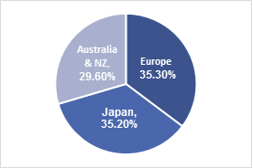
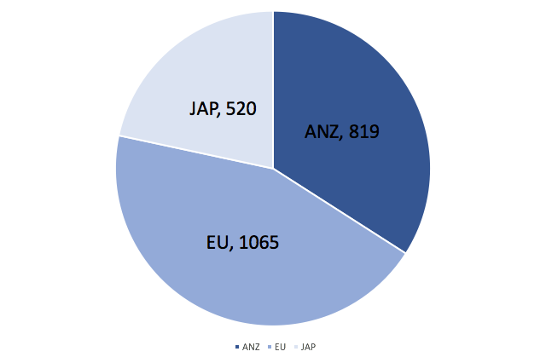
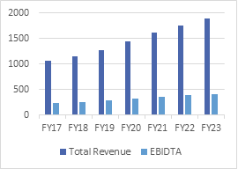
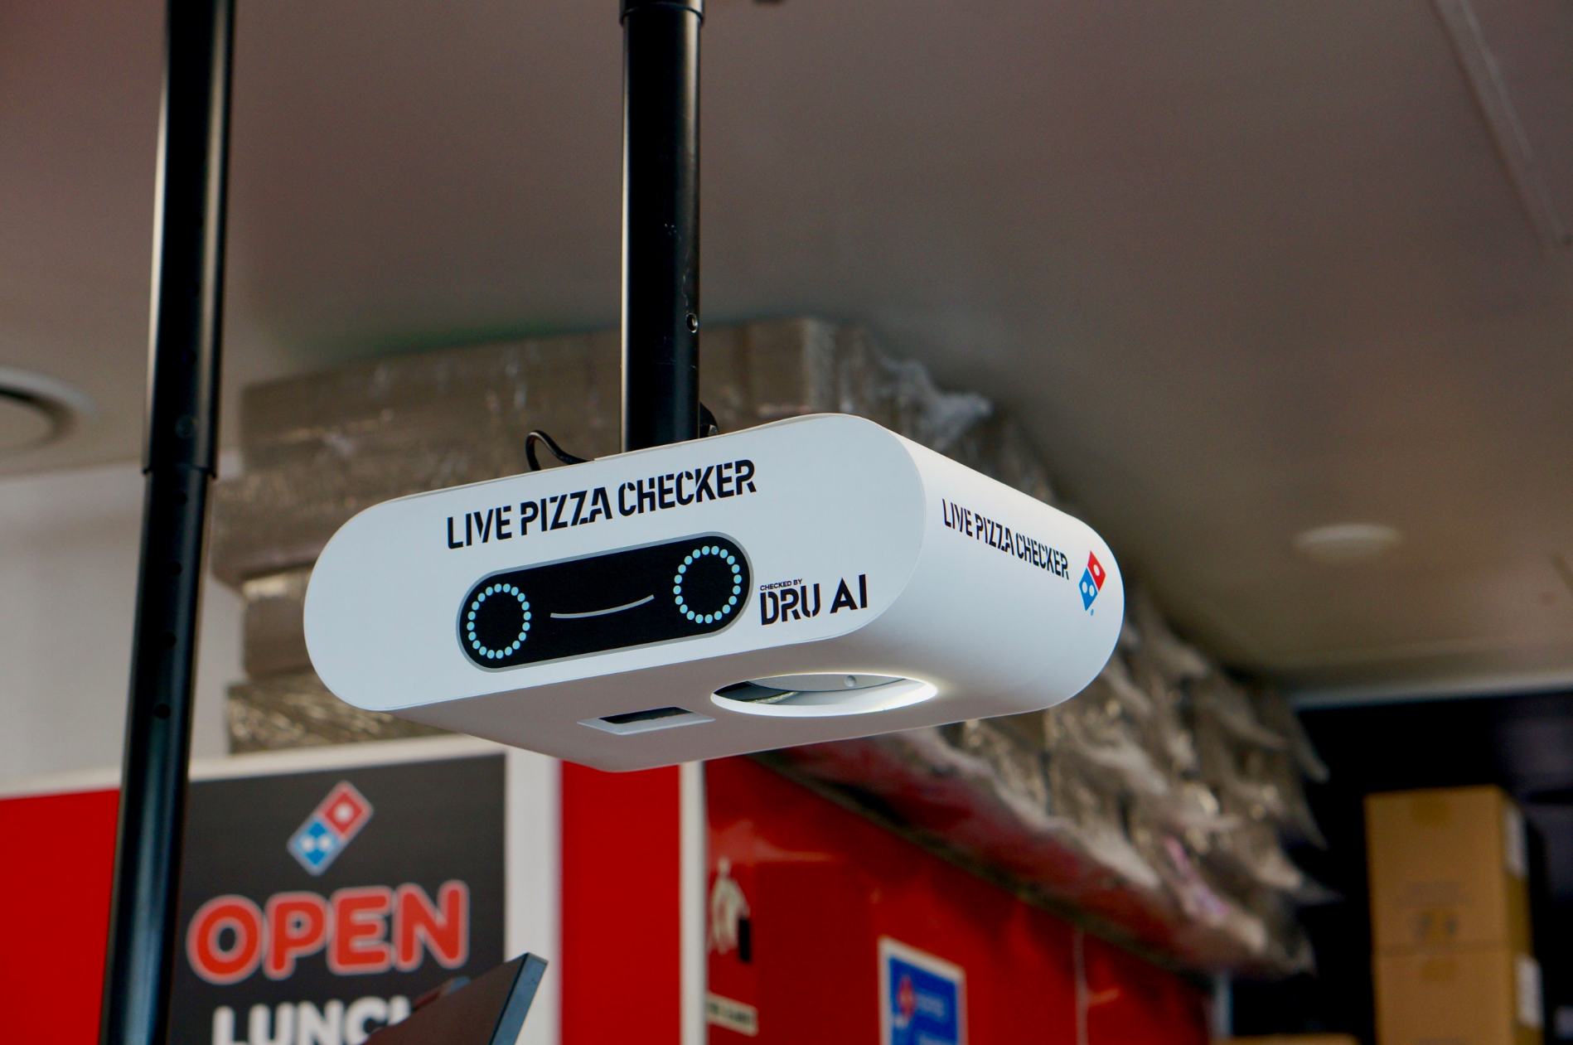

Company Overview
Based in Brisbane, Australia, Domino's Pizza Enterprises Limited opened its first store in 1983. It has since then grown to a network of 2400 stores worldwide.
Business Description
Geographical Statistics
DMP is the largest master franchisee of the Domino's Brand.
It holds franchise rights in 7 different countries, namely: Australia, New Zealand, France, Germany, Belgium, Netherlands, Luxembourg and Japan.
Expansion through store splitting and acquisitions
Revenue stream: corporate and franchise stores
Strategy: technology + goal (Project3TEN)
Sales
Store Count
Revenue & EBITDA Growth Trend
Advanced Technology
Pizza Checker
Company Overview
Executive Summary
Industry Overview
Thesis 1
Thesis 2
Thesis 3
Thesis 4
Valuation & Risks

Slide 12
Industry Overview
Understanding the company’s position in the industry (e.g. market share, competitive advantage)
Porter’s 5 Analysis / SWOT Analysis
Outlook and trends of the industry

Slide 13
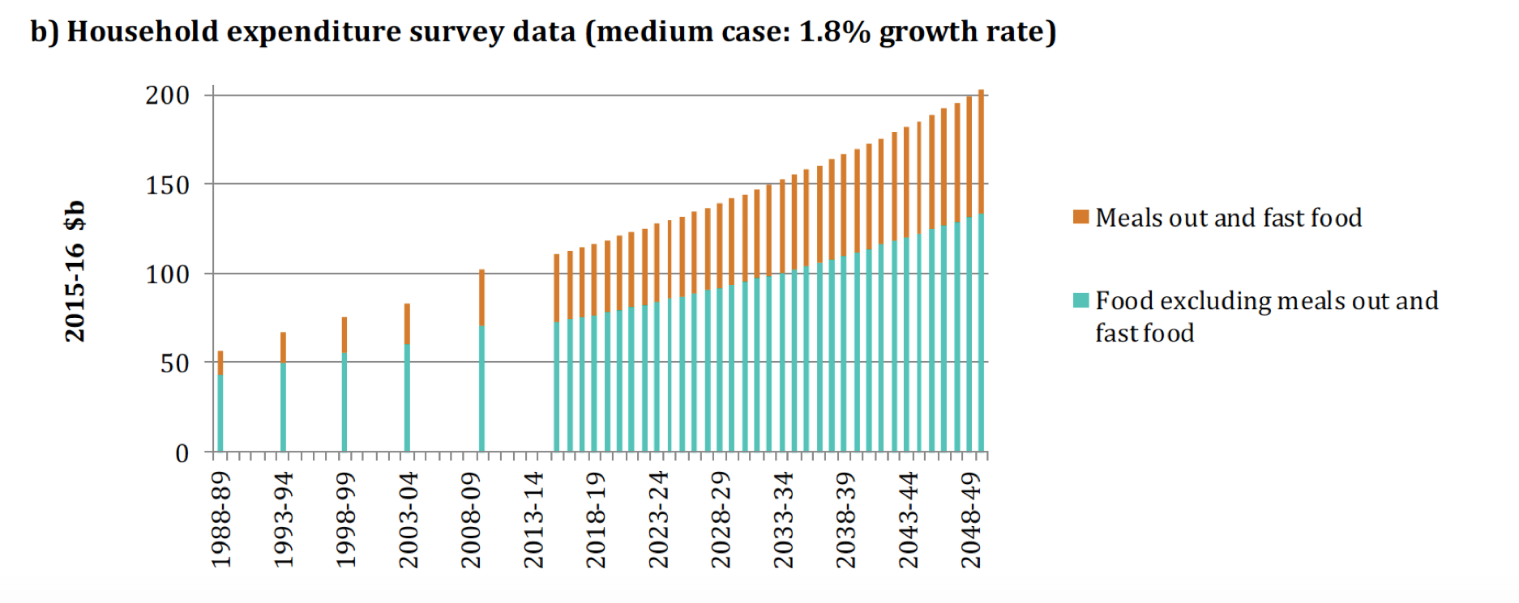
Industry Overview
Food Consumption Growth
Main drivers of food consumption: Population Growth & Income
Australia:
Population growth: 1.3% --> Household food expenditure $92b - $165b
Meals out and Fast Foods: $37b - $69b
Europe:
Population growth: 0.19% CAGR from 2020-2025
Western Europe: 2nd largest pizza market after US
Japan:
Pizza is a luxury, willing to pay 2x as much as western counterparts
Expect 6x as much choices
Rising Digital Ordering and Takeaway Delivery Markets
Takeaway Delivery Market: seen 73% increase. Grow at CAGR of 3.7% p.a. 2018-2020
34% of Australians claim pizza to be fav delivery food
¼ of digital orders made through mobile app, industry said to grow to $38b
 | FY2018 | Year-on-Year Growth (%)
Total Online Sales | $1655.5m | 19.4%
ANZ | n.d. | 11.8%
Europe | n.d. | 32.3%
Japan | n.d. | 11.6%
Threat of Competitive Rivalry: High
Highly fragmented with many players
TECHNOLOGY
Threat of Substitute Products: High
Availability of alternatives
Low switching costs
Alternative Meat Market (8.3%) outpaces Quick-Service Restaurants (2%)
Industry Overview
Executive Summary
Company Overview
Thesis 1
Thesis 2
Thesis 3
Thesis 4
Valuation & Risks

Slide 14
Investment Thesis
Reasons to long or short the stock
Aim to find theses that are different from the market
Unique based on individuals’ acumen
Key aspect that differentiates investors
Best approach is not to read analysts’ reports first

Slide 15
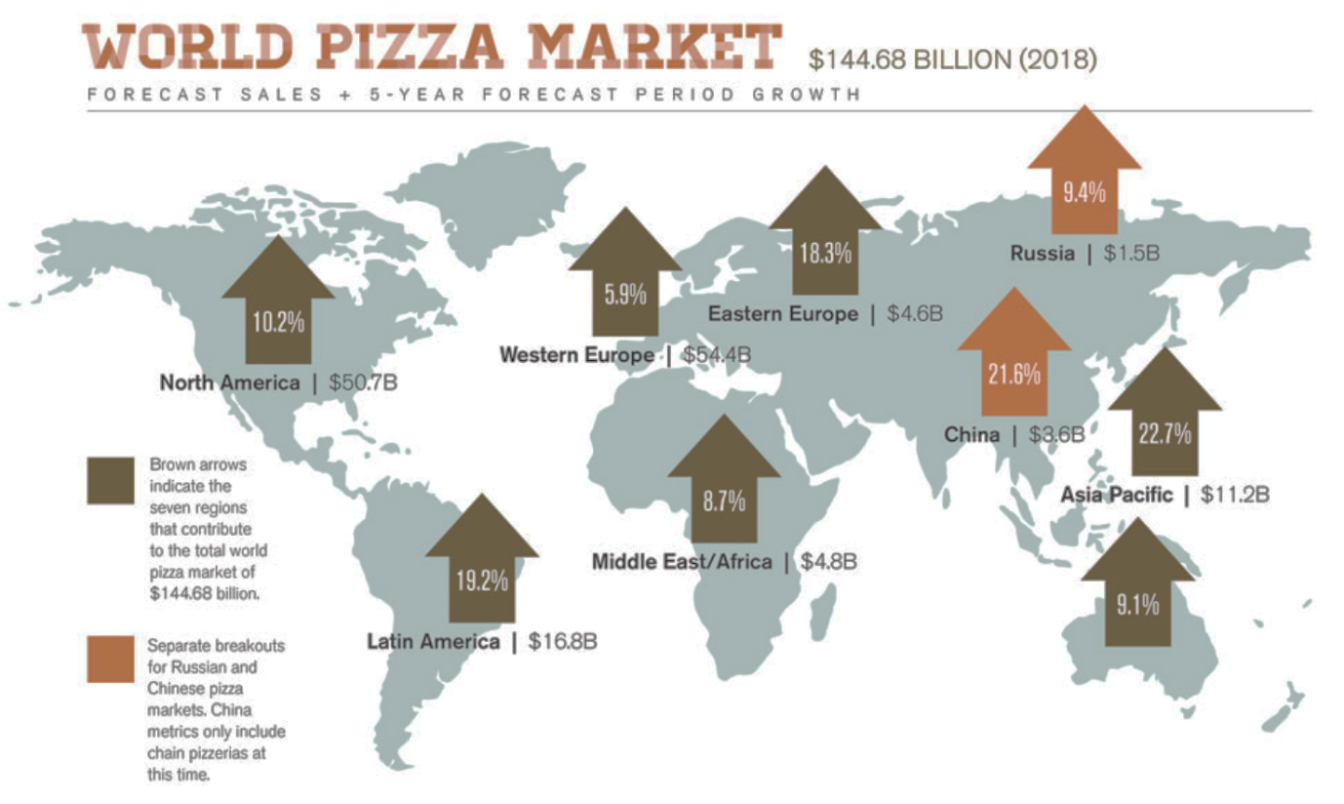
Thesis 1: Significant Headroom In The Core Geographical Markets
Management’s focus on expansion
Core Geographical Markets Continue To Grow
Management reaffirms guidance of 4650 stores by 2025, an increase of 94.3% from current store counts. This suggests significant room for expansion.
Well-executed strategies to fuel long-term growth
Acquisition of Hallo Pizza’s 170 stores of which 130 stores have agreed to convert to Domino’s Pizza franchises. It is forecasted to increase same store sales between 3%-6% across the group, increase of approximately $227-$247 million to the EBIT
Massive growth potential of the Benelux region which has seen high double digit SSS and SSC in both Netherlands and Belgium
Store spilt to accommodate higher population density & size
Outperforming industry & competitors which are seeing stagnating or declining sales

Slide 16
Thesis 2: Increased Efficiencies & Franchise Profitability
Management shift to capital light model through franchises
Management shift to capital light model through franchises
Australia/ NZ stores | FY16 | FY17 | FY18
Franchised Stores | 649 | 703 | 733
Corporate Stores | 65 | 74 | 86
European stores
Franchised Stores | 753 | 794 | 991
Corporate Stores | 63 | 71 | 63
Japan Stores
Franchised Stores | 133 | 183 | 218
Corporate Stores | 320 | 310 | 302
Summary
Consolidated # of Stores | 1983 | 2135 | 2393
Franchised store % | 77% | 79% | 81%
Europe % of total stores | 41% | 41% | 44%
Japan % of total stores | 23% | 23% | 22%
We expect continued improvement in EBIDTA margins. Japanese & European operations have large room for operational improvements
Stabilisation in CAPEX
Ongoing cost control measures and technological endeavours bring about higher margins and franchise profitability

Slide 17
Valuation – Intrinsic
Discounted cash flow model:
Model in investment theses
Requires several assumptions (e.g. revenue growth projections, expenses as a % of revenue, capex as a % of revenue)
Find free cash flow (“cash is king”) and then project it out for the next 5-10 years
Discount it to the present to find intrinsic value
Discount factor includes finding cost of capital (WACC): cost of equity (CAPM) & cost of debt (credit default spread + risk free rate)

Slide 18
Valuation – Relative
Peers comparison: to get a sensing of whether the stock is overvalued or undervalued
Price to Earnings (Stock price divide by earnings per share)
-High growth companies, increasing profits
Price to Book (Stock price divide by net asset per share)
-Companies with valuable assets e.g. real estates
Price to Sales (Stock price divide by sales per share)
-Normally for start ups

Slide 19
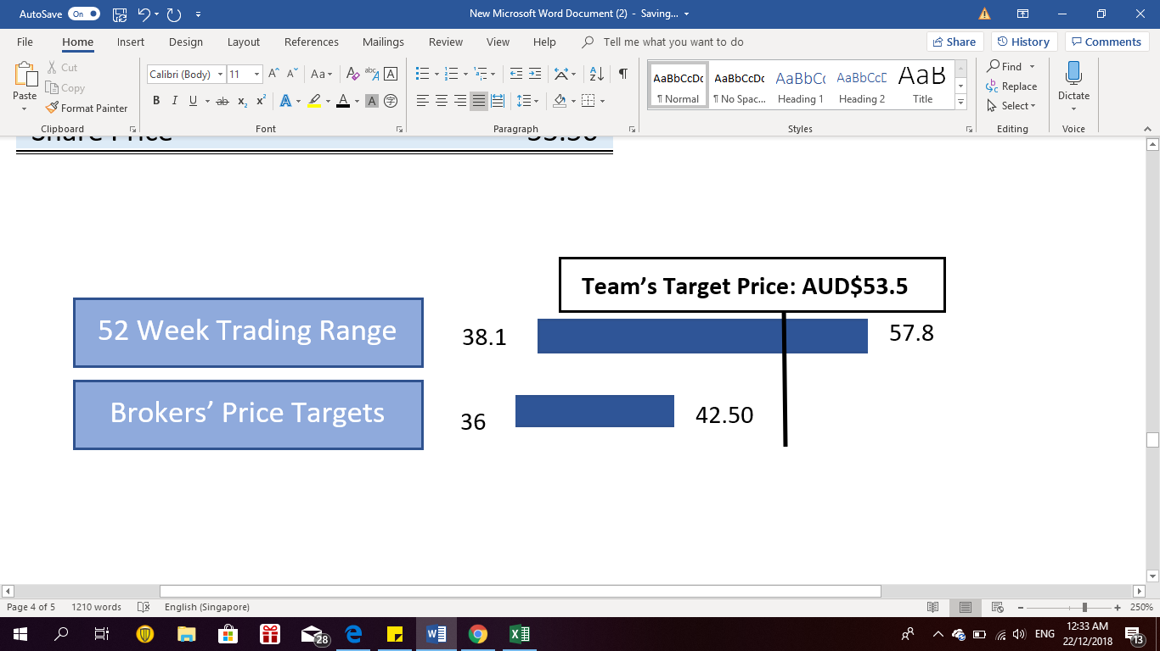
Valuation
Key Inputs
Free Cash Flows Projections
Inputs | Value
Risk Free Rate | 2.75%
Risk Premium | 5.08%
Beta | 1.35
CAPM Cost of Equity | 9.61%
Default Spread | 0.54%
Pre Tax Cost of Debt | 3.29%
After Tax Cost of Debt | 2.30%
Debt Weightage | 66%
Equity Weightage | 34%
WACC | 4.79%
Terminal Value Growth Rate | 2.75%
Terminal Value | 6,261
Free Cash Flows Projections | Historical |  |  |  |  | Forecast
Financial Year | 2014 | 2015 | 2016 | 2017 | 2018 | 2019 | 2020 | 2021 | 2022 | 2023
Currency | AUD | AUD | AUD | AUD | AUD | AUD | AUD | AUD | AUD | AUD
Revenue | 585 | 698 | 924 | 1,065 | 1,143 | 1,286 | 1,494 | 1,681 | 1,851 | 2,005
EBIT*(1-T) | 69 | 93 | 131 | 164 | 182 | 149 | 178 | 206 | 233 | 260
Capex | (37.6) | (59.7) | (86.8) | (66.0) | (54.1) | (70.0) | (70.0) | (70.0) | (70.0) | (70.0)
Cash Acquisitions | (244.7) | (12.2) | (174.5) | (25.8) | (112.5) | (113.9) | (113.9) | (113.9) | (113.9) | (113.9)
Depreciation | 21.7 | 27.5 | 38.1 | 46.4 | 53.5 | 61.4 | 72.8 | 83.6 | 93.9 | 103.7
Changes in operating working capital | 0.0 | 222.5 | 111.2 | 72.2 | 52.3 | 53.91 | 55.52 | 57.19 | 58.91 | 60.67
Free cash flow | (191.6) | (173.8) | (203.8) | 46.6 | 17.0 | (27.9) | 11.1 | 48.5 | 84.3 | 118.7
Intrinsic Value
Valuation Summary
Valuation
Forecast period PV | 246
Terminal value PV | 4,956
Enterprise Value | 5201
(+)Cash & equivalents | 76
(-)Total borrowings | 599
Equity Value | 4679
# of shares | 87
Share Price | 53.56
Valuation & Risks
Executive Summary
Company Overview
Industry Overview
Thesis 1
Thesis 2
Thesis 3
Thesis 4

Slide 20
Investment Risks
Acknowledge the fact that it’s impossible to predict the future
Potential risks that could hinder your theses / achieve the target price
Need to be as objective as possible

Slide 21
Risks Matrix
High
Unsuccessful menu rollout
Slowdown in long term store growth
Wage Frauds
Guidance misses
Impact
Medium
Interest rate risk
Foreign exchange risk
Excessive store splits
Commodities prices
Conversion & Integration
Low
Legal Disputes
Low Medium High
Probability
Valuation & Risks
Executive Summary
Company Overview
Industry Overview
Thesis 1
Thesis 2
Thesis 3
Thesis 4

Slide 22
Platforms For Further Learning
Wall Street Oasis
Breaking Into Wall Street
Corporate Finance Institute
Aswath Damodaran (“Dean of Valuation”)

Slide 23
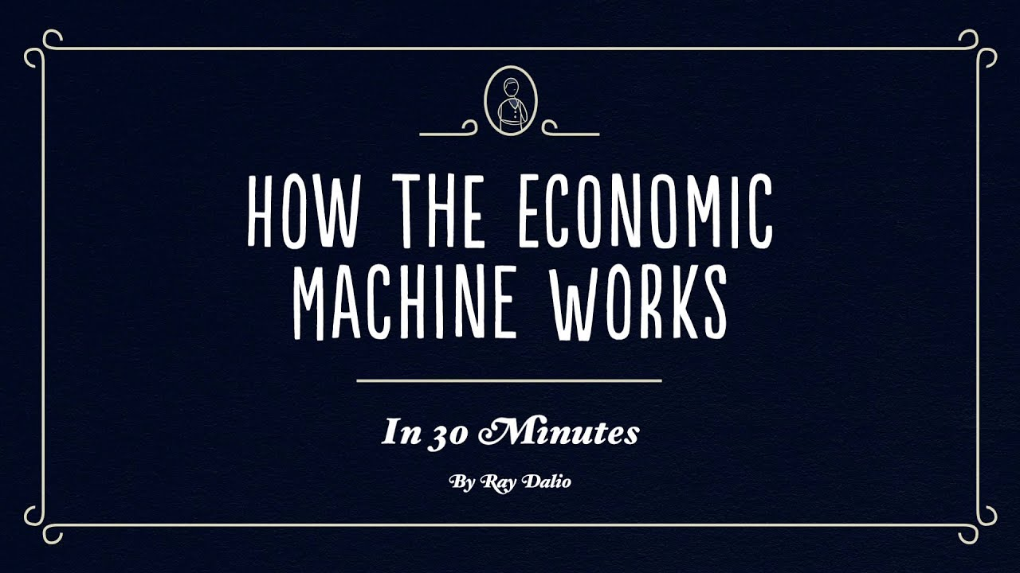
Understanding The Economy
How The Economic Machine Works in 30 Minutes By Ray Dalio (YouTube)

Slide 24
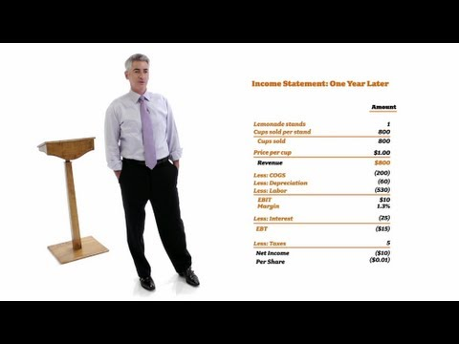
Understanding The Basics of Finance
William Ackman: Everything You Need to Know About Finance and Investing in Under an Hour (YouTube)

